Slide 1

COMPUTER NETWORKS
MODULE IV

Slide 2
Transport Layer: Transport layer services provided to the upper layers elements of transport protocol addressing connection establishment, Connection release, Error Control & Flow Control. Internet Transport Protocols: UDP vs TCP, The TCP Service Model, The TCP Segment Header, Connection Establishment, Connection Release. TCP Sliding Window and Congestion Control Algorithm.

Slide 3
INTRODUCTION
oThe transport layer is responsible for the delivery of a message from one process to another
oThe transport layer header must include a service – point –address in the OSI model or port number in the TCP/IP (internet model)
oThe Internet model has three protocols at the transport layer:
UDP, TCP, and SCTP.
UDP: Is the simplest of the three.
TCP: A complex transport layer protocol.
SCTP: The new transport layer protocol that is designed for specific applications such as multimedia. a new reliable, message-oriented transport layer protocol that combines the best features of UDP and TCP

Slide 4
PROCESS-TO-PROCESS DELIVERY
oThe Data link layer is responsible for delivery of frames between nodes over a link node to node delivery using a MAC address to choose one node among several.
The Network layer is responsible for delivery of datagrams between two hosts host to host delivery using an IP address to choose one host among millions.
Real communication takes place between two processes (application programs). We need process-to-process delivery.
oWe need a mechanism to deliver data from one of process running on the source host to the corresponding process running on the destination host.
oThe Transport layer is responsible for process-to-process . We need a port
number, to choose among multiple processes running on the destination host.

Slide 5
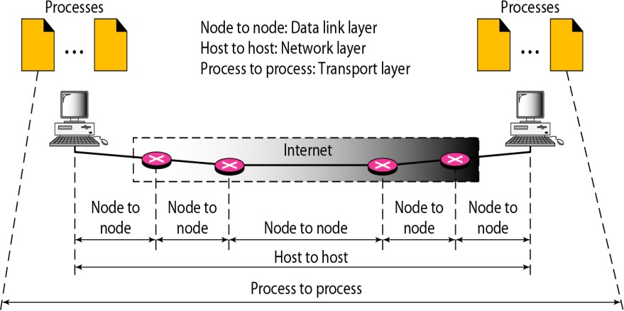
TYPES OF DATA DELIVERIES

Slide 6
CLIENT/SERVER PARADIGM
o process-to-process communication can be achieved through client/server
oA process on the local host, called a client, needs services from a process usually on the remote host, called a server.
oBoth processes (client and server) have the same name.
oFor example, to get the day and time from a remote machine, we need a Daytime client process running on the local host and a Daytime server process running on a remote machine.
oA remote computer can run several server programs at the same time, just as local computers can run one or more client programs at the same time.

Slide 7
PORT NUMBER
oIn the Internet model, the port numbers are 16-bit integers between 0 and 65,535.
oThe client program defines itself with a port number, chosen randomly by the transport layer software running on the client host
oThe server process must also define itself with a port number This port
number, however, cannot be chosen randomly
oThe Internet uses port numbers for servers called well- known port numbers.
oEvery client process knows the well-known port number of the corresponding server process
o For example, while the Daytime client process, can use an ephemeral (temporary) port number 52,000 to identify itself, the Daytime server process must use the well-known (permanent) port number 13.

Slide 8
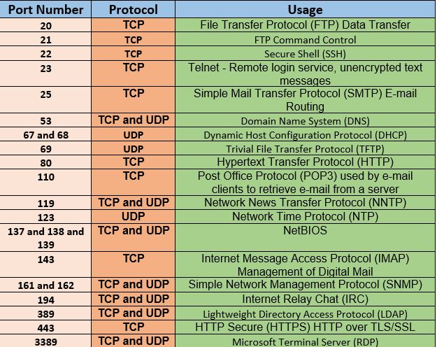

Slide 9
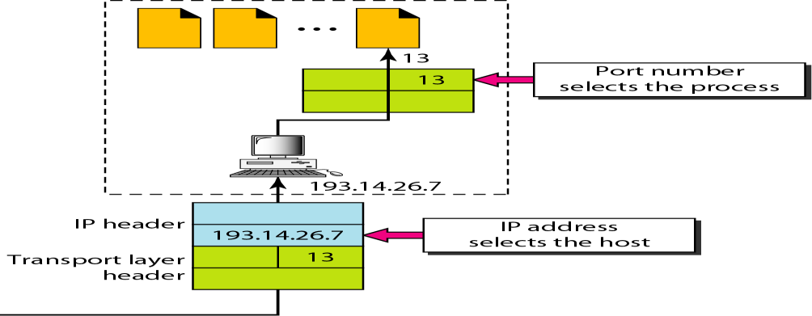
IP ADDRESSES VERSUS PORT NUMBERS
IP addresses and port numbers play different roles in selecting the final
destination of data.
The destination IP address defines the host among the different hosts
After the host has been selected, the port number defines one of the processes on this particular host

Slide 10
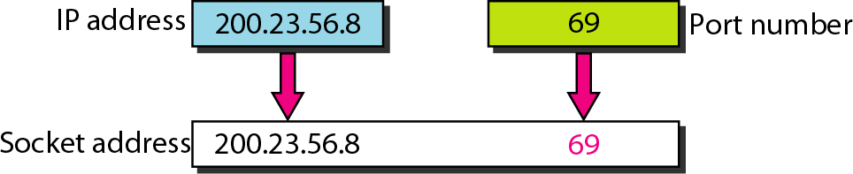
SOCKET ADDRESSES
o Process-to-process delivery needs two identifiers, IP address and the port
number, at each end to make a connection.
oThe combination of an IP address and a port number is called a socket address.
oA transport layer protocol needs a pair of socket addresses: the client socket address and the server socket address.
oThese four pieces of information are part of the IP header and the transport layer protocol header.
The IP header contains the IP addresses; the UDP or TCP header contains the port numbers.

Slide 11
Connectionless or Connection- Oriented
oA transport layer protocol can either be connectionless or connection-
oriented.
oConnectionless Service
In a connectionless service, the packets are sent from one party to another with no need for connection establishment or connection release.
The packets are not numbered; they may be delayed or lost or may arrive out of sequence.
There is no acknowledgment.
oConnection Oriented Service
In a connection-oriented service, a connection is first established between the sender and the receiver.
Data are transferred.
At the end, the connection is released. ( virtual connection , not a physical
connection)

Slide 12

R E L I AB LE VERSUS U N R E L I A B L E
oThe transport layer service can be reliable or unreliable.
oIf the application layer program needs reliability, we use a reliable transport layer protocol by implementing flow and error control at the transport layer. This means a slower and more complex service.
oOn the other hand, if the application program does not need reliability then an unreliable protocol can be used.
Note
oUDP is connectionless and unreliable;
oTCP and SCTP are connection oriented and reliable.
These three protocols can respond to the demands of the
application layer programs.

Slide 13

UDP is located between the application layer and the IP layer, and serves as the intermediary between the application programs and the network operations.
UDP

Slide 14



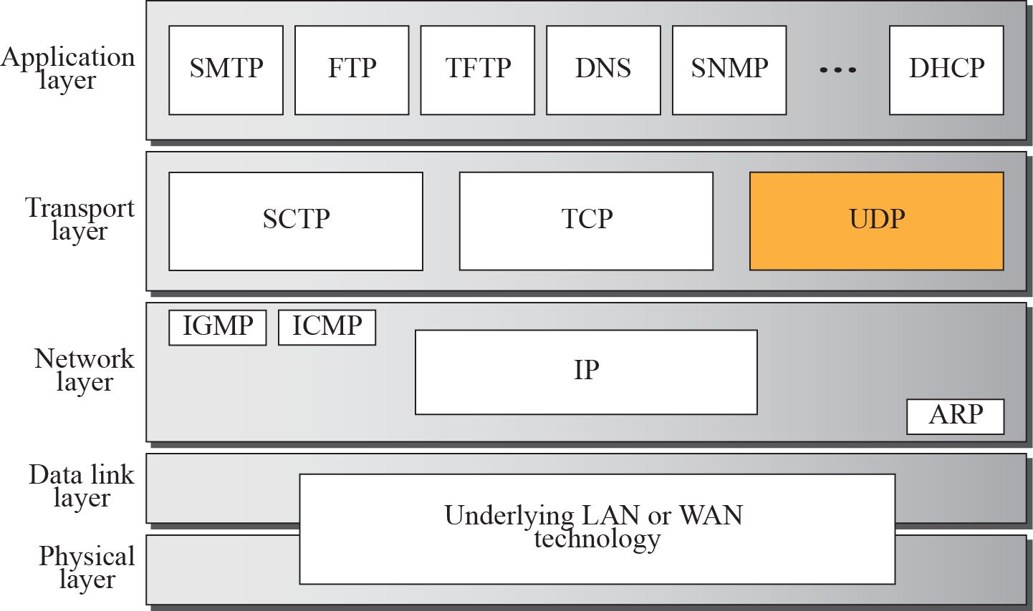
Figure 14.1
Position of UDP in the TCP/IP protocol suite
TCP/IP PROTOCOL SUITE
16

Slide 15
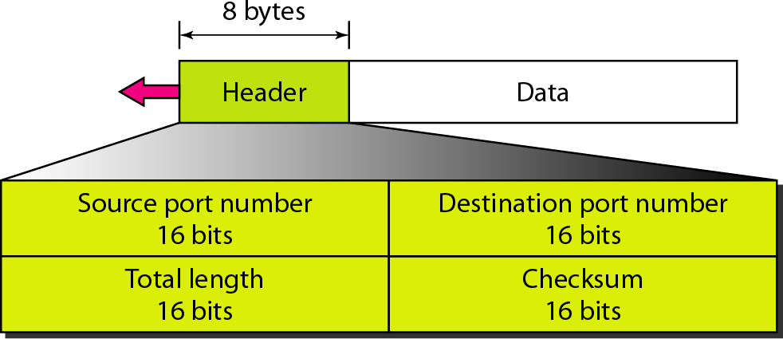
1. USER DATAGRAM PROTOCOL (UDP )
oUDP is a connectionless, unreliable transport protocol.
oIt does not add anything to the services of IP (very simple) except to provide process-to process communication instead of host-to-host communication.
o(when to use it?) If a process wants to send a small message and does not care much about reliability, it can use UDP.
UDP
called
packets,
user
datagrams,
have
a header bytes.
fixed-size of 8
https://www.youtube.com/watch?v=blV7WUZpkCE
UDP packets, called user datagrams, have a fixed size header of 8 bytes.

Slide 16
U D P CHARACTERISTICS
End-to-End: an application sends/receives data to/from another application.
Connectionless: Application does not need to preestablish communication before sending data; application does not need to terminate communication when finished.
Message-oriented: application sends/receives individual messages (UDP datagram), not packets.
Best-effort: same best-effort delivery semantics as IP. I.e. message can be
lost, duplicated, and corrupted.
Arbitrary interaction: application communicates with many or one other applications.
Operating system independent: identifying application does not depend on O/S.

Slide 17
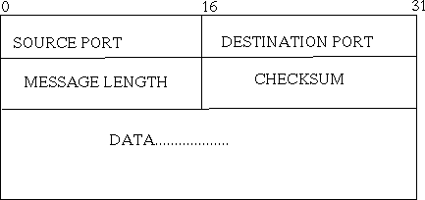
U DP DATAGRAM FORMAT
Source Port - 16 bit port number
Destination Port - 16 bit port number
Length (of UDP header + data) - 16 bit count of octets
UDP checksum - 16 bit field. if 0, then there is no checksum, else it is a checksum
over a pseudo header + UDP data area

Slide 18
2. TRANSMISSION CONTROL PROTOCOL(TCP)
oTCP, like UDP, is a process-to-process (program-to- program) protocol uses port numbers.
oUnlike UDP, TCP is a connection oriented protocol; it creates a virtual connection between two TCPs to send data.
oTCP uses flow and error control mechanisms at the transport level.

Slide 19

23-3 TCP
TCP is a connection-oriented protocol; it creates a virtual connection between two TCPs to send data. In addition, TCP uses flow and error control mechanisms at the transport level.
Topics discussed in this section:
TCP Services TCP Features
Segment
A TCP Connection
Flow Control
Error Control

Slide 20
Table 23.2 Well-known ports used by TCP

Slide 21
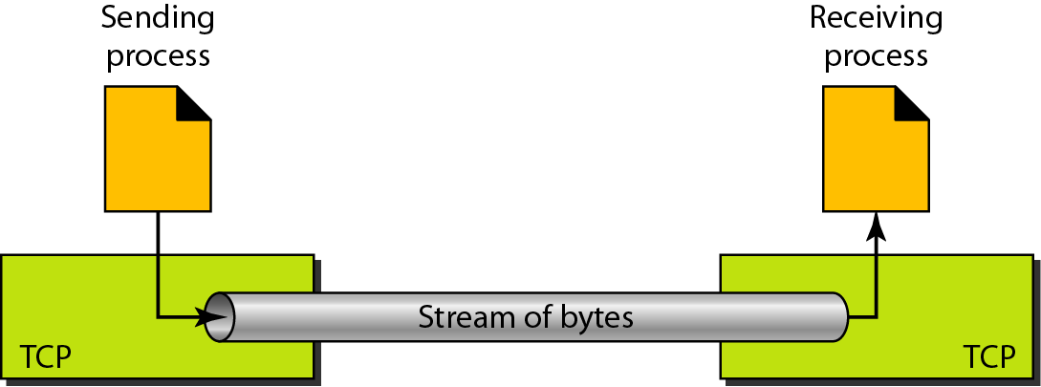
Figure 23.13 Stream delivery

Slide 22
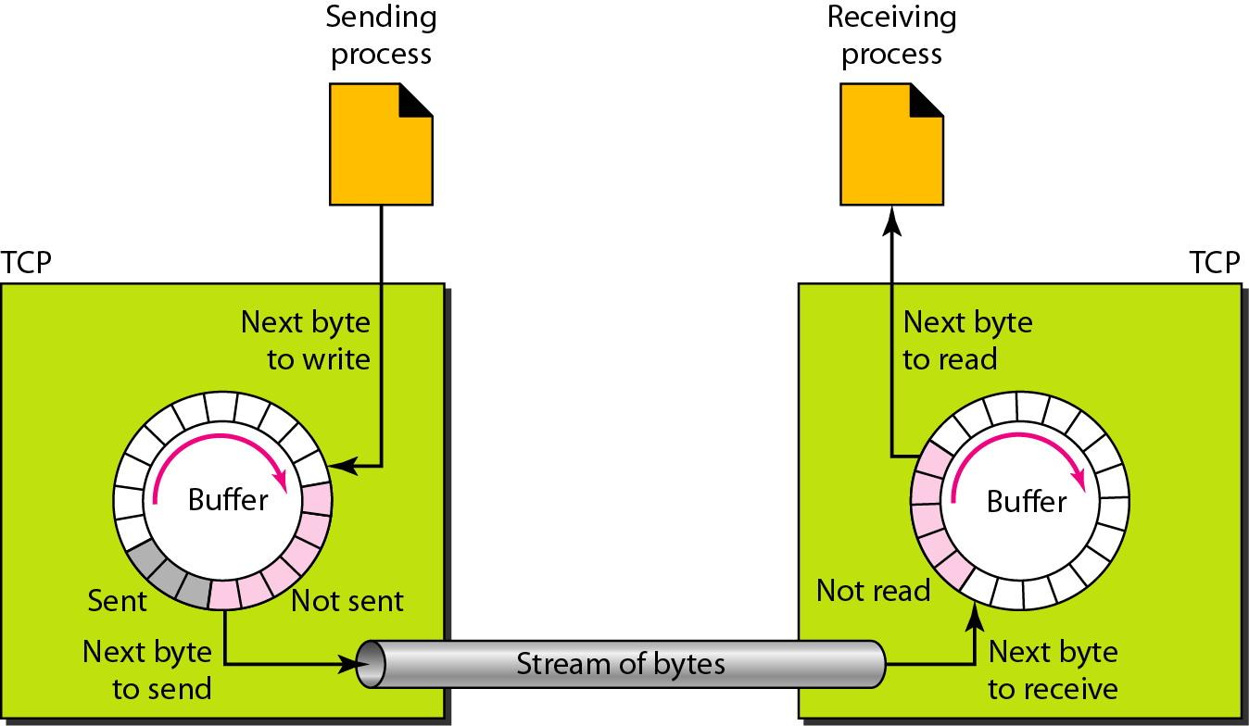
Figure 23.14 Sending and receiving buffers

Slide 23
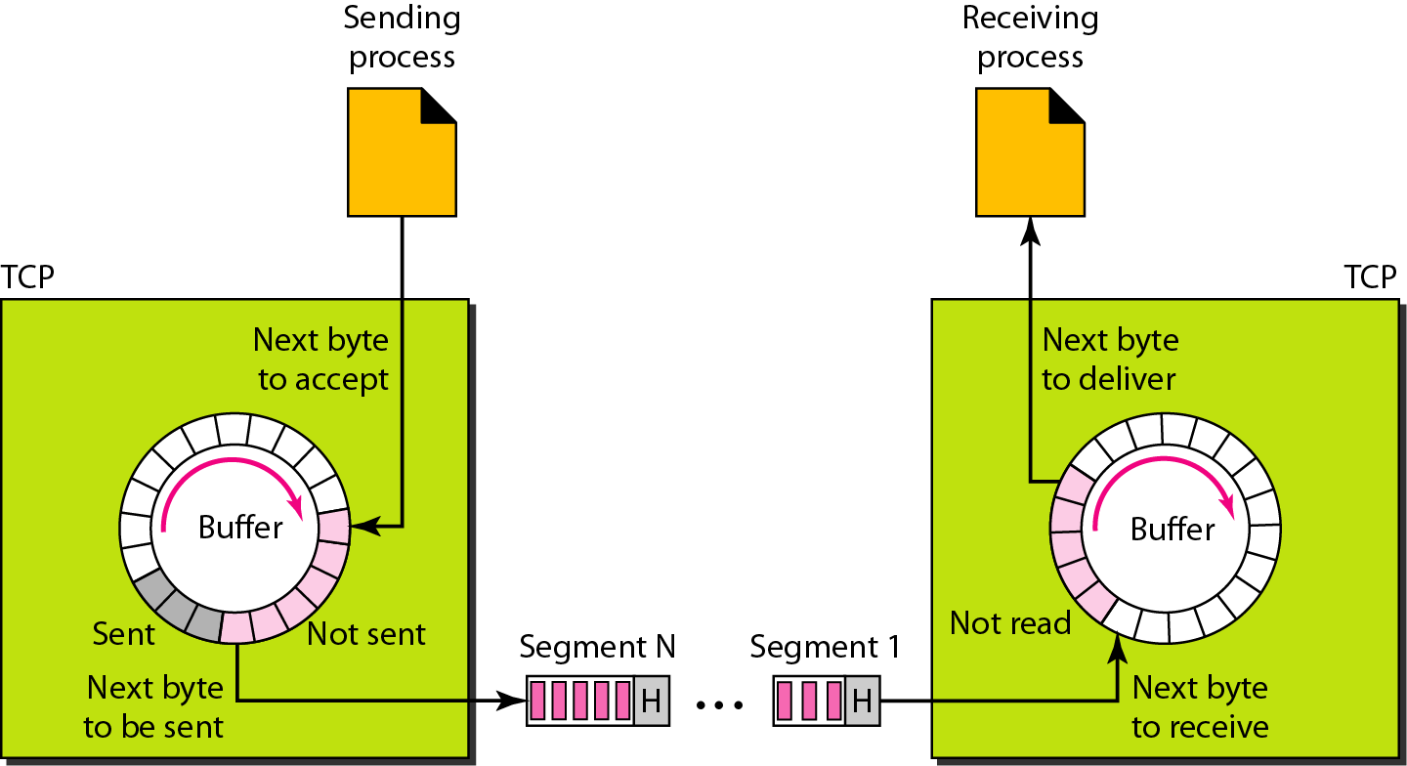
Figure 23.15 TCP segments

Slide 24

Note
The bytes of data being transferred in each connection are numbered by TCP.
The numbering starts with a randomly generated number.

Slide 25
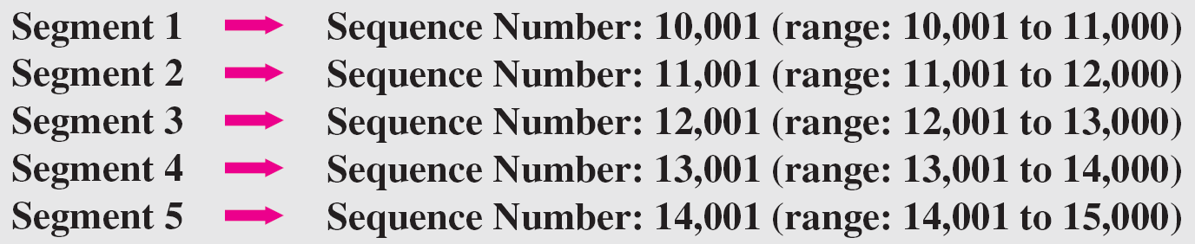
Example 23.3
The following shows the sequence number for each segment:

Slide 26
Note
The value in the sequence number field of a segment defines the
number of the first data byte contained in that segment.

Slide 27
Note
The value of the acknowledgment field in a segment defines
the number of the next byte a party expects to receive.
The acknowledgment number is cumulative.

Slide 28
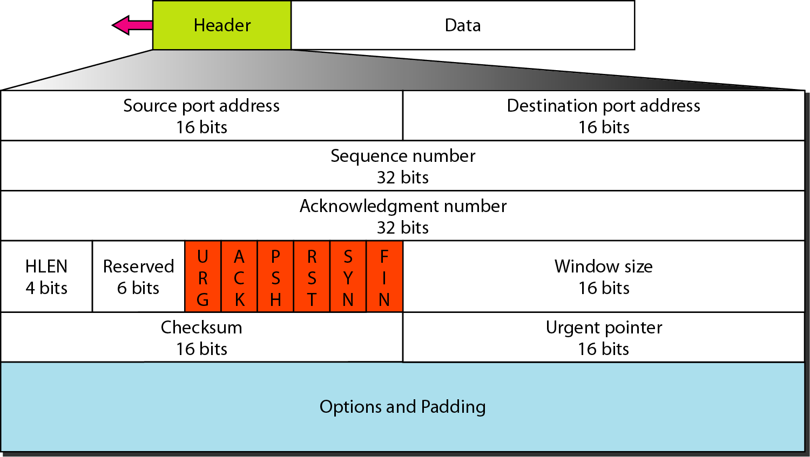
Figure 23.16 TCP segment format

Slide 29
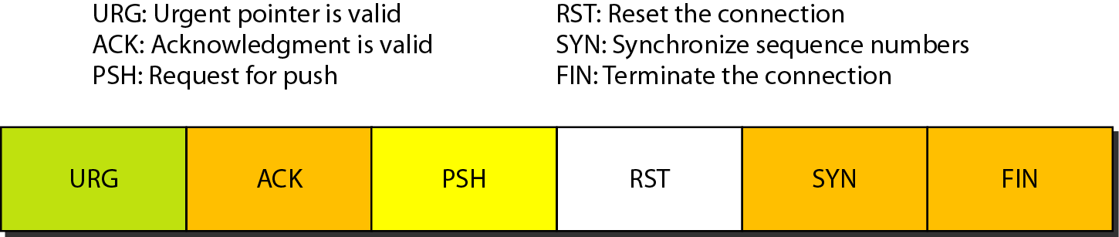
TCP SEGMENT FORMAT
Reserved. This is a 6-bit field reserved for future use.
Control: This field defines 6 different control bits or flags. One or more of these bits can be set at a time. These bits enable flow control, connection establishment and termination, connection abortion, and the mode of data transfer in TCP

Slide 30
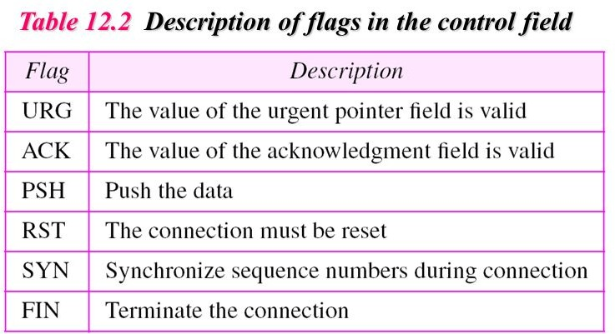

Slide 31
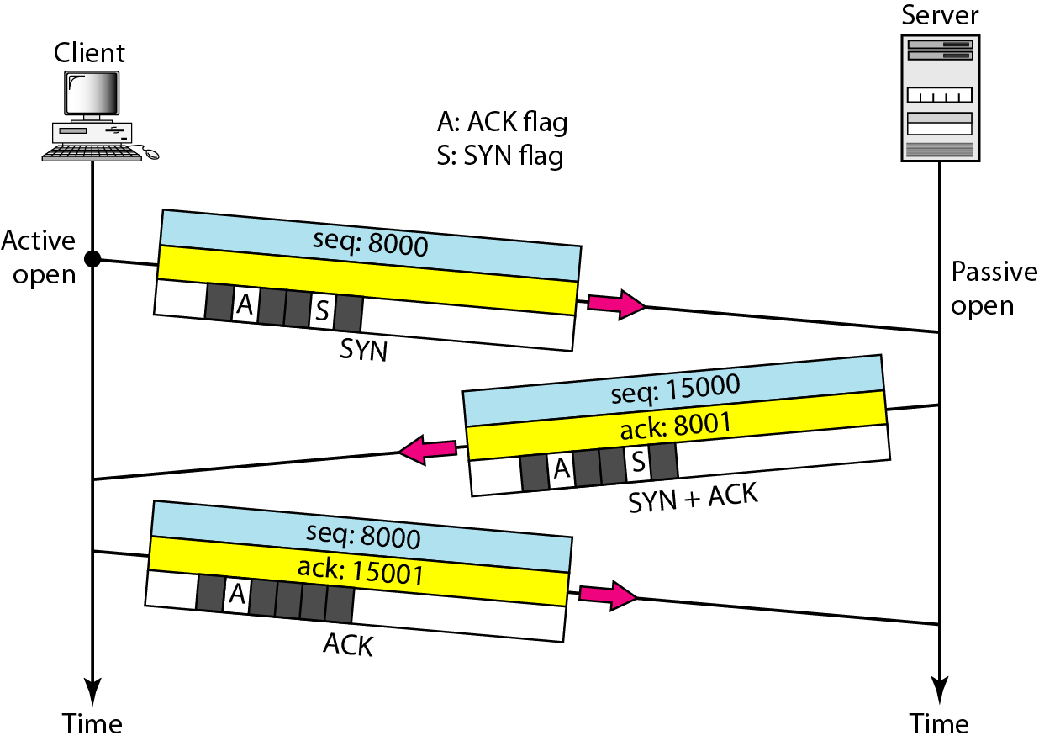
Figure 23.18 Connection establishment using three-way handshaking

Slide 32
Note
A SYN segment cannot carry data, but it consumes one sequence number.

Slide 33
Note
A SYN + ACK segment cannot carry data, but does consume one sequence number.

Slide 34
Note
An ACK segment, if carrying no data, consumes no sequence number.

Slide 35
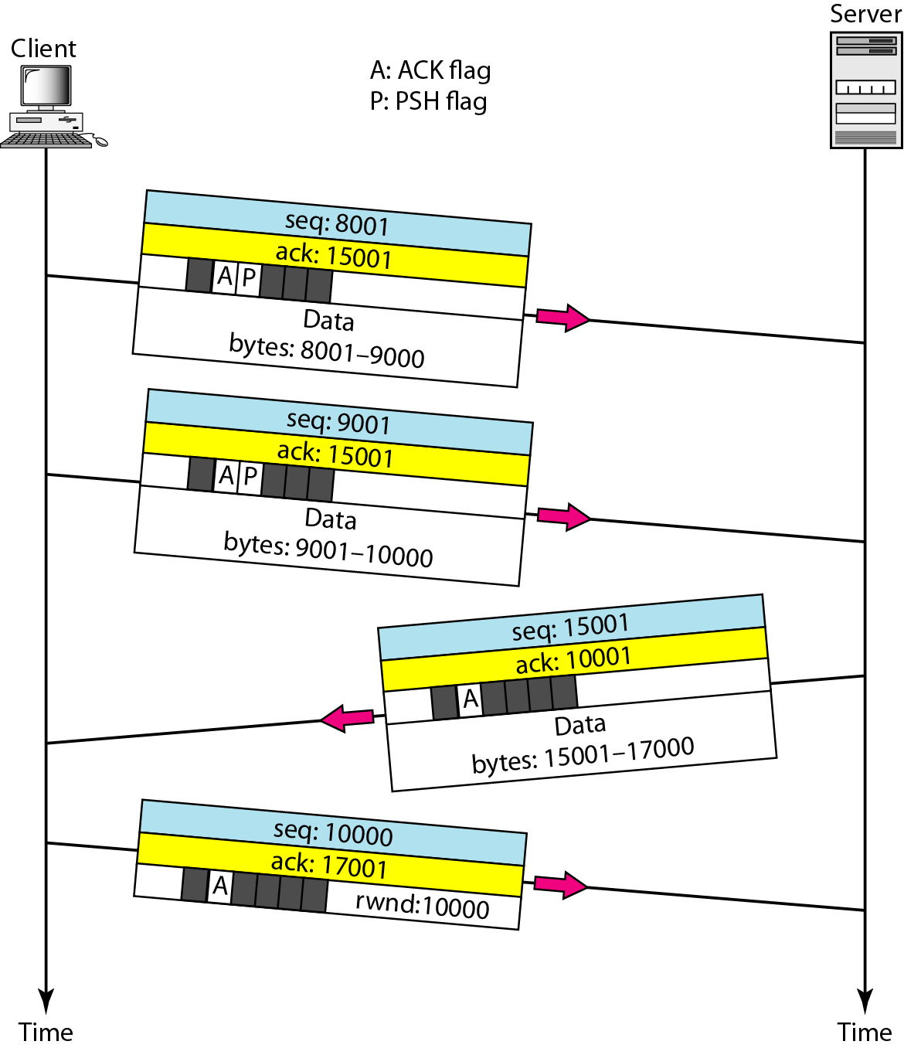
Figure 23.19 Data transfer

Slide 36
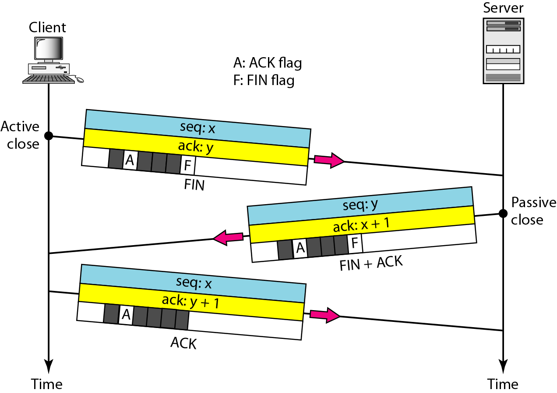
Figure 23.20 Connection termination using three-way handshaking

Slide 37
Byte numbering is used for flow and error control. For example: if the random number happens to be 1057 and the total data to be sent are 6000 bytes, the bytes are numbered from 1057 to 7056.
After the bytes have been numbered, TCP assigns a sequence number to each segment that is being sent.
The sequence number for each segment is the number of the first byte carried in that segment

Slide 38
Acknowledgment Number
Each party uses an acknowledgment number to confirm the bytes it has received.
The acknowledgment number defines the number of the next byte that the party expects to receive.

Slide 39

B. T C P S E G M E N T F O R M AT

Slide 40
TCP Segment Format
The segment consists of a 20-60-byte header. Source port address:
This is a 16-bit field , it defines the port number of the application program in the
host that is sending the segment.
Destination port address:
This is a 16-bit field, it defines the port number of the application program in the host that is receiving the segment.
Sequence number: This 32-bit field defines the number assigned to the first byte of
data contained in this segment.
Acknowledgment number: This 32 bit field defines the number of the next byte a party expects to receive.
Header length: A 4-bit field that indicates the number of 4-byte words in the TCP header. The length of the header can be between 20 and 60 bytes. Therefore, the value of this field can be between 5 (5 x 4 =20) and 15 (15 x 4 =60).

Slide 41
TCP SEGMENT FORMAT
Reserved. This is a 6-bit field reserved for future use.
Control: This field defines 6 different control bits or flags. One or more of these bits can be set at a time. These bits enable flow control, connection establishment and termination, connection abortion, and the mode of data transfer in TCP

Slide 43
TCP SEGMENT FORMAT
Urgent data :
oThe data are presented from the application program to TCP as a stream of bytes.
o Each byte of data has a position in the stream.
oIf the sending application program wants a piece of data to be read out of order by the receiving application program., the sending TCP creates a segment and inserts the urgent data at the beginning of the segment.
oThe rest of the segment can contain normal data from the buffer
o

Slide 44
TCP SEGMENT FORMAT
Urgent data :
oThe urgent pointer field in the header (if its set) defines the end of the urgent data and the start of normal data.
oWhen the receiving TCP receives a segment with the URG bit set, it extracts the urgent data from the segment using the value of the urgent pointer, and delivers them, out of order, to the receiving application program.

Slide 45
THREE-WAY HANDSHAKING PROCESS
The client sends the first segment, a SYN segment, in which only the SYN flag is set.
This segment is for synchronization of sequence numbers. It consumes one sequence
number.
When the data transfer starts, the sequence number is incremented by 1.
The SYN segment carries no real data
The server sends the second segment, a SYN +ACK segment, with 2
flag bits set: SYN and ACK.
This segment has a dual purpose. It is a SYN segment for communication in the other direction and serves as the acknowledgment for the SYN segment.
It consumes one sequence number.

Slide 46
THREE-WAY HANDSHAKING PROCESS
The client sends the third segment. This is just an ACK segment.
It acknowledges the receipt of the second segment with the ACK flag
and acknowledgment number field.
The sequence number in this segment is the same as the one in the SYN segment.
✴ The ACK segment does not consume any sequence numbers.

Slide 47
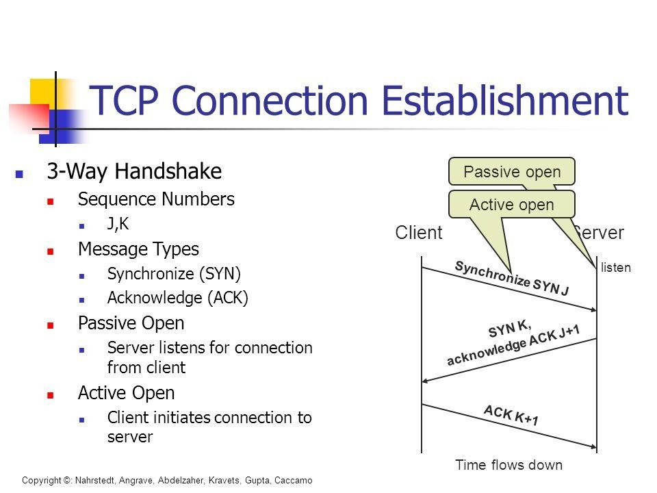
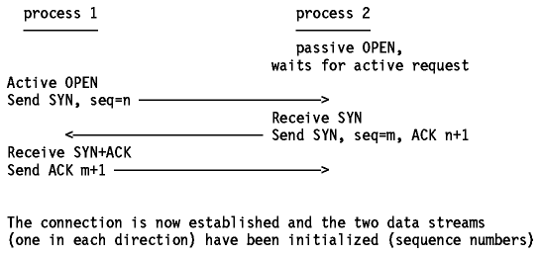

Slide 48
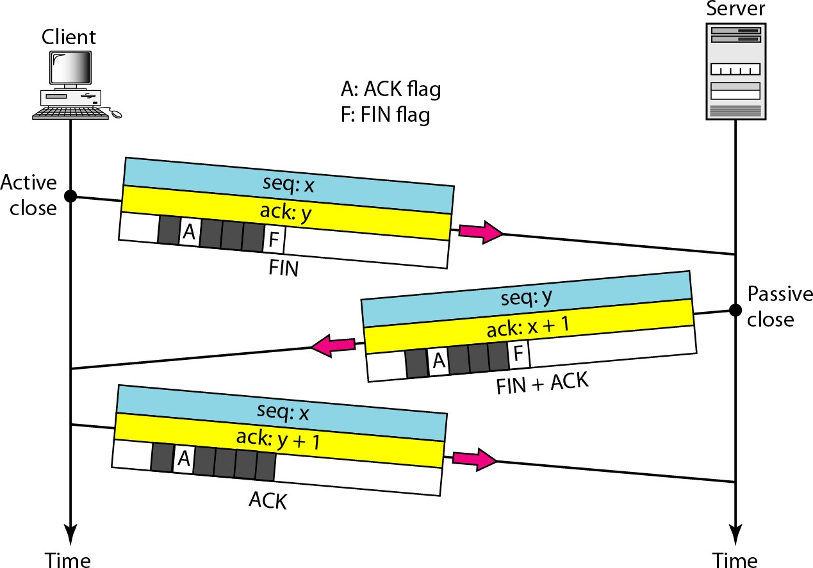
Any of the two parties involved in exchanging data (client or server) can close
the connection using three-Way Handshaking

Slide 49
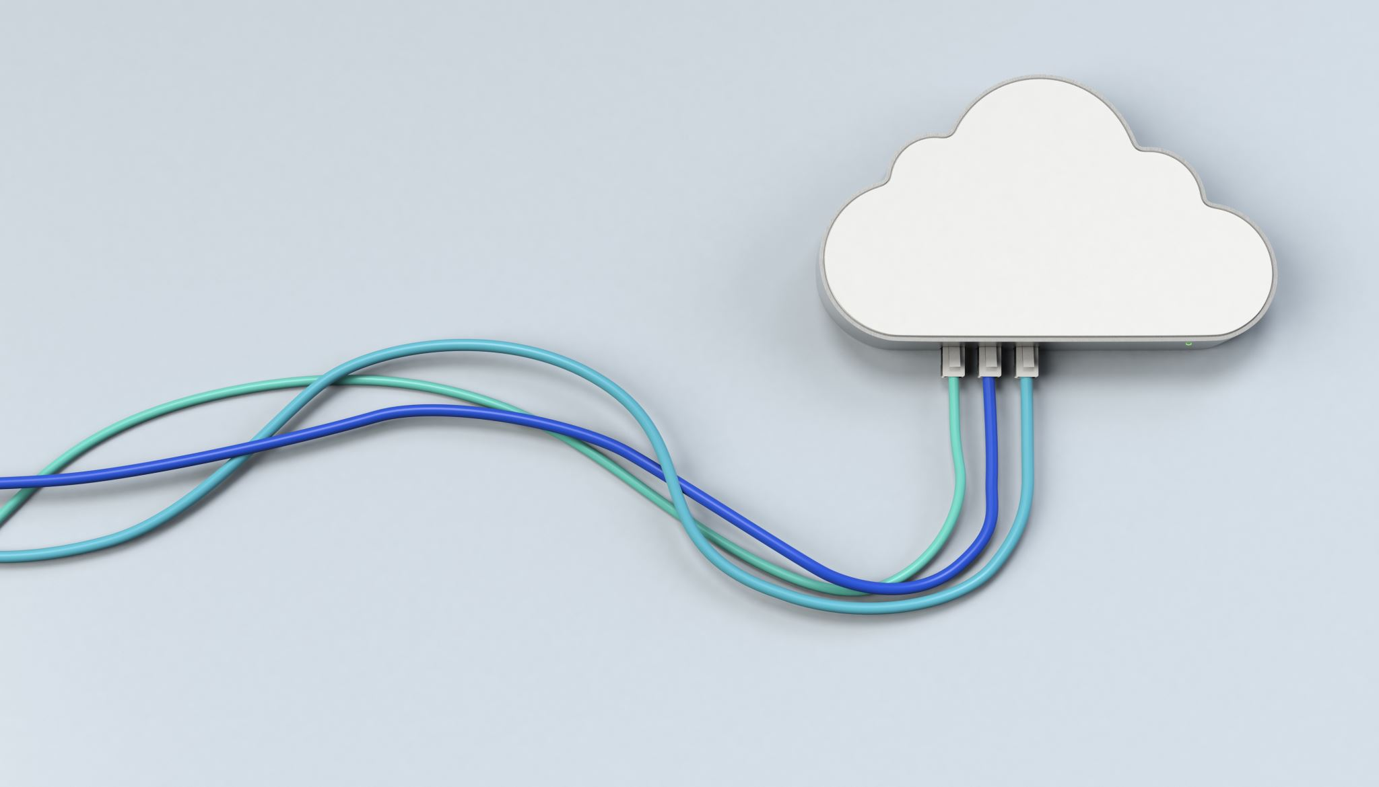
Flow Control:
When a data frame (Layer-2 data) is sent from one host to another over a single medium, it is required that the sender and receiver should work at the same speed.
That is, sender sends at a speed on which the receiver can process and accept the data.
What if the speed (hardware/software) of the sender or receiver differs? If sender is sending too fast the receiver may be overloaded, (swamped) and data may be lost.
Two types of mechanisms can be deployed to control the flow:
Stop and wait
Sliding Window

Slide 50
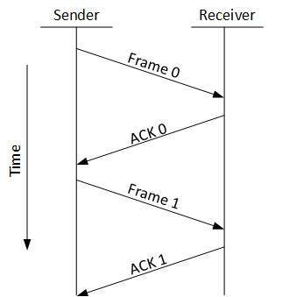
Stop and Wait:
This flow control mechanism forces the sender after transmitting a data frame to stop and wait until the acknowledgement of the data-frame sent is received.

Slide 51
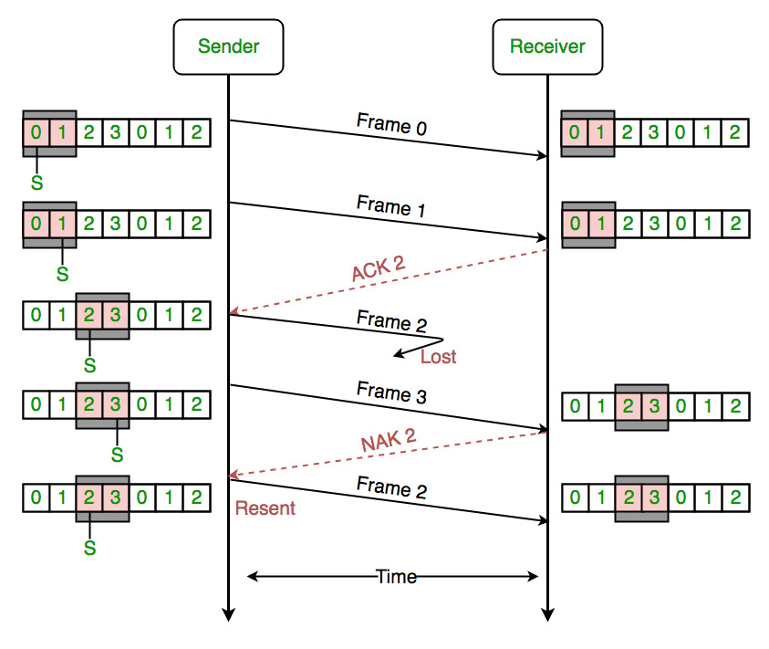
Sliding Window
In this flow control mechanism, both sender and receiver agree on the number of data-frames after which the acknowledgement should be sent.
As we learnt, stop and wait flow control mechanism wastes resources, this protocol tries to make use of underlying resources as much as possible.

Slide 52
SCTP
In computer networking, the Stream Control Transmission Protocol (SCTP) is a transport-layer protocol, serving in a similar role to the popular protocols TCP and UDP. It is standardized by IETF in RFC 4960.

Slide 53
SCTP
SCTP adds to the mix is multi-homing. Multi-homing allows the
two endpoints of a connection to declare multiple interfaces (IP
addresses). Providing and alternate route for the data in case the current interface in use fails for some reason.
The second feature is multi-streaming. Rather than use a single
stream of data, SCTP can create multiple streams that can be used independently.
This doesn’t really improve the speed of the medium but it allows
the data to arrive concurrently; minimizing the wait time for
pages to completely load. This feature also prevents control
packets from getting blocked by data packets, like what usually happens in TCP; thereby improving data control.
TCP’s 3-way handshake initiation, SCTP uses a 4-way handshake that allocates resources near the end of the entire handshake

Slide 54
SCTP
Data in TCP comes in packets. Packets have a specific size and a long stream would be divided to fit while short ones are spliced together. This means that message framing must be provided at the application layer to fully identify separate messages. SCTP implements message framing and each message would always have the same size when it comes out as it came in.
Summary:
SCTP Is better at multi-homing than TCP
SCTP has multi-streaming while TCP doesn’t
SCTP has initiation protection while TCP doesn’t
SCTP has message framing while TCP doesn’t
Ordered delivery is optional with SCTP but not with TCP

